Slide 1
Types of Data
AJ

Slide 2
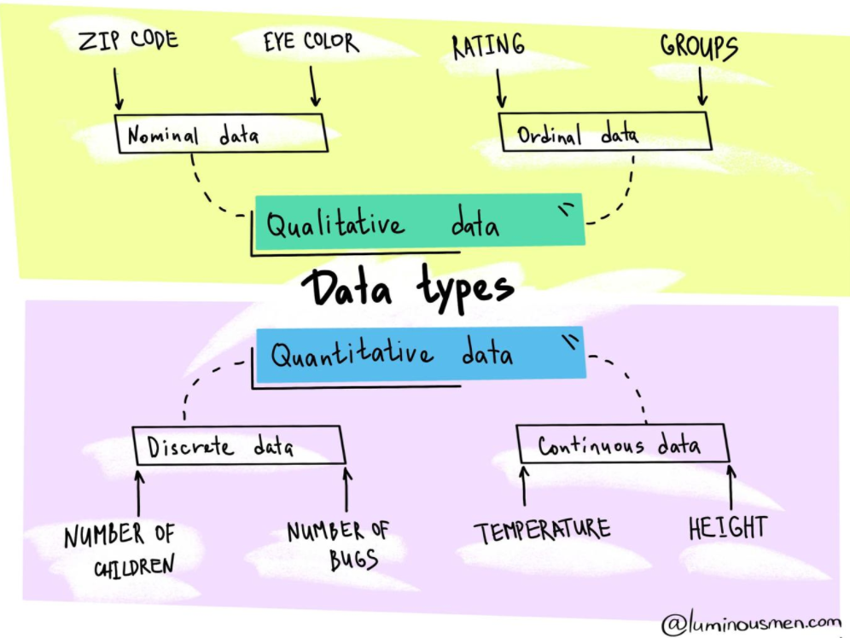
Data Types
Understanding the different types of data, allows you to pick the right data type as per your tasks like EDA,ML,DL,ETC.
Image source: https://luminousmen.com/

Slide 3
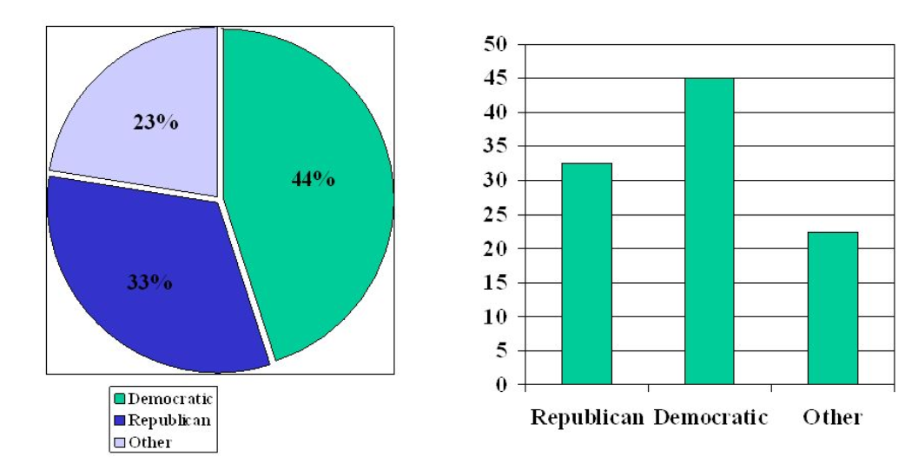
Qualitative: Nominal Data
Nominal data are used to label variables where there is no quantitative value and has no order. So, if you change the order of the value then the meaning will remain the same.
Examples of Nominal Data:
Gender (Women, Men)
Hair color (Blonde, Brown, Brunette, Red, etc.)
Marital status (Married, Single, Widowed)

Slide 4
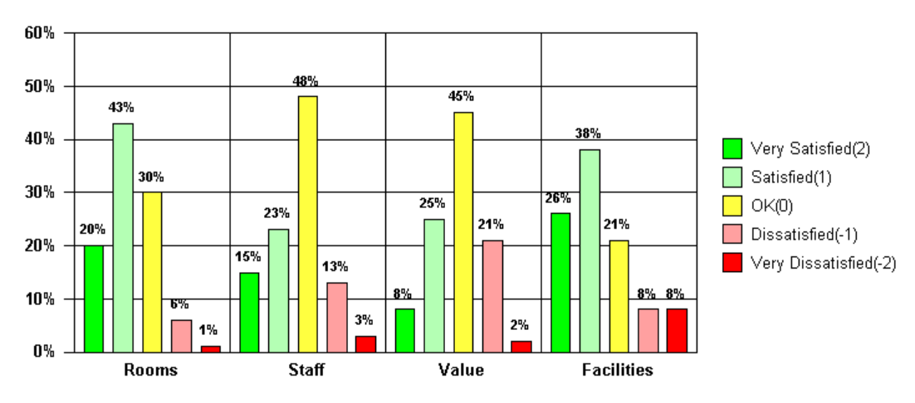
Qualitative: Ordinal Data
Ordinal data is almost the same as nominal data but not in the case of order as their categories can be ordered like 1st, 2nd, etc. However, there is no continuity in the relative distances between adjacent categories.
Examples of Ordinal Data:
Ranking of users in a competition: The first, second, and third, etc.
Rating of a product taken by the company on a scale of 1-10.
Economic status: low, medium, and high.

Slide 5
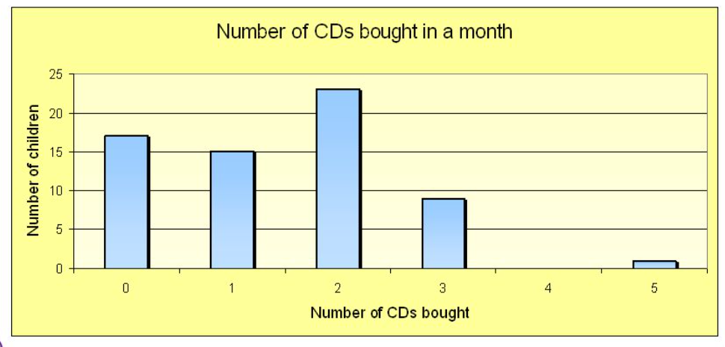
Quantitative: Discrete Data
A discrete scale is one that is quantitative, but it does not take up all the space.
Examples of discrete data:
The number of students in a class.
The number of workers in a company.
The number of test questions you answered correctly.

Slide 6
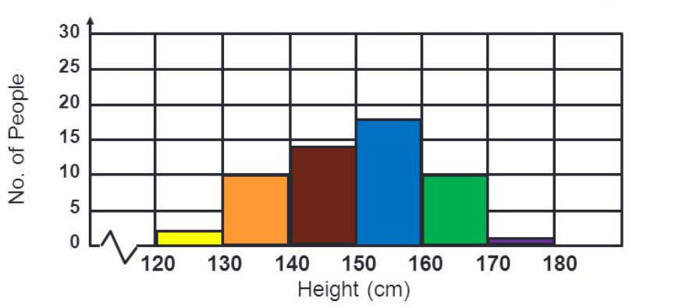
Quantitative: Continuous Data
A continuous scale is a scale that takes up all the space, it can be anything from -∞ to +∞, can be fractional.
Examples of continuous data:
The amount of time required to complete a project.
The height of children.
The speed of cars.

Slide 7
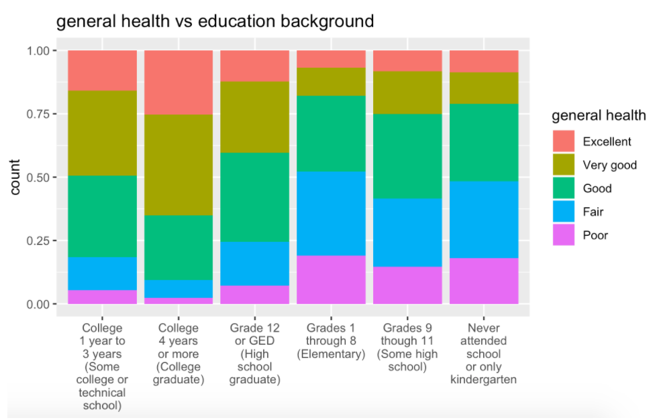
Quantitative: Continuous Data-Ratio
Ratio values are also ordered units that have the same difference. Ratio values are the same as interval values, with the difference that they do have an absolute zero.
Example of Ratio data:
Age (from 0 years to 100+)
Temperature (in Kelvin, but not °C or F)
Time interval (measured with a stopwatch or similar)

Slide 8
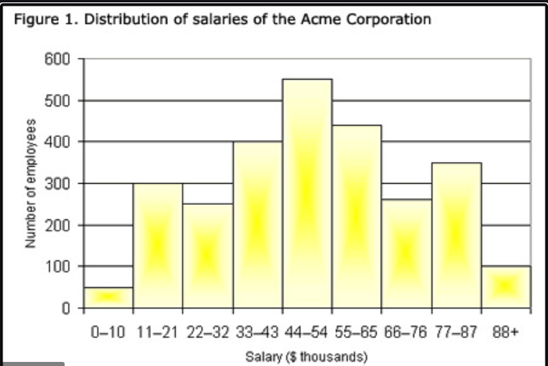
Quantitative: Continuous Data-Interval
Interval values represent ordered units that have the same difference. Therefore we speak of interval data when we have a variable that contains numeric values that are ordered and where we know the exact differences between the values.
Examples of Interval data:
Temperature (°C or F, but not Kelvin)
Dates (1055, 1297, 1976, etc.)
Time Gap on a 12-hour clock (6 am, 6 pm)

